Slide 1
Adding members to ArcGIS Online

Slide 2
Adding individual members to ArcGIS online
Click on the image to access the video tutorial
This video covers:
Adding users via email
Assigning Groups
Allocating Credits
Setting an appropriate role for the user
Photo by Brooke Cagle on Unsplash

Slide 3
Adding members to ArcGIS online via a spreadsheet
Click on the image to access the video tutorial
This video covers:
Adding members from a spreadsheet
Assigning Groups
Allocating Credits
Items to note:
Members will be asked to change their password when they first login. Using ‘password1’ as the initial password in the spreadsheet keeps things simple. The member could then change the password to the same one they use to login to the school network.
The spreadsheet with the user details needs to be set out in a specific way and saved as a .csv file in Excel. Copy the template below into Excel to get started.
Only 200 new members can added from a single spreadsheet.
For additional information about adding members refer to our help files found here.
Photo by Val Vesa on Unsplash
Email | First Name | Last Name | Username | Password | Level | Role | Allow Esri Access
 |  |  |  | password1 | 2 | User | TRUE

Slide 4
Save time on ArcGIS online administration with the Admin Tools app
Click on the image to access the video tutorial
This video covers:
How to add the Admin Tools app to ArcGIS Online.
How the Admin Tools app can be used to make bulk changes to members, groups and content in ArcGIS Online.
How to change the Role of multiple members in one process.
N.B. The Admin Tools app from Geojobe is free to use in ArcGIS Online.

Slide 5
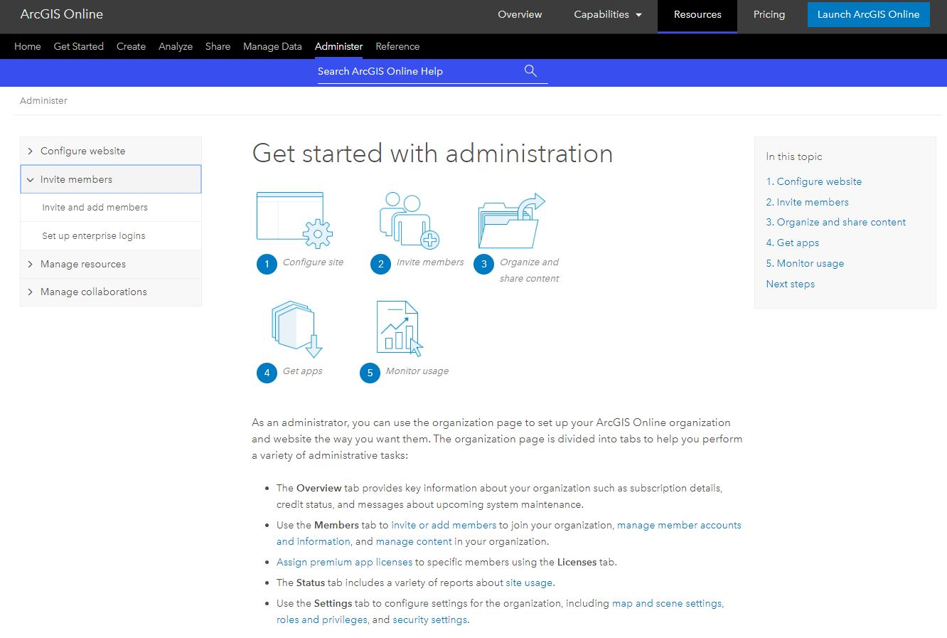
Setting up Single Sign On for access to ArcGIS Online
Click on the image to access the relevant help pages
Students and staff can access ArcGIS Online using their existing school network logins if Single Sign On is configured.
If you would like to configure your ArcGIS Online account to use Single Sign On please see the help files linked on this slide.
There are also some helpful blogs for connecting to G-Suite and Azure AD:
Google G-Suite
Microsoft Azure AD

Slide 6
For more help, support and teaching ideas for ArcGIS Online please visit our schools resources website:
https://schools.esriuk.com/

